Slide 1



Govern · Know · Act
Data and AI engineering
for modern businesses.
From trusted data foundations through to production AI, and the applications the work lives in.
BASED IN
PARTNER
DELIVERING ACROSS
Pune, India
Anthropic Certified
India, APAC, UK and US
Notes:
woodfrog is a data and AI engineering company in Pune. Three layers: govern the data, know what is happening, act on it with AI.

Slide 2
The shape of the firm.
AT A GLANCE
02 / 13
Founded in Pune in 2023. A small senior team, delivering across India, APAC, the UK and the US.
50+
20+
18
3
Projects delivered
Clients served
People on the team
Senior people on your engagement, no bench
6
2023
4
Fixed
Weeks, median, to the first production result
Founded, in Pune
Regions: India, APAC, UK and US
Scope and price, NDA-friendly terms
PARTNER
CONTACT
Anthropic Certified Services Partner
hello@woodfrog.tech
Notes:
Small on purpose. The people on the first call are the people who build it.

Slide 3



Plenty of data. Little use of it.
THE PROBLEM WE SOLVE
03 / 13
What we hear in almost every first call, from manufacturers to SaaS companies.
01
02
03
It sits in a dozen systems.
Nobody trusts the numbers.
Skilled people, repeat work.
ERP, CRM, spreadsheets, machines and email. Every report means someone stitching exports together by hand.
Dashboards multiply one request at a time. Nobody can say where a KPI comes from, or why it moved.
Retyping invoices, checking applications, chasing follow-ups, writing the same report every week.
WHAT IT COSTS
WHAT IT COSTS
WHAT IT COSTS
Numbers arrive after the moment to act has passed.
Meetings start with whose number is right.
Headcount grows with volume, not with the business.
Notes:
Start with the pain the buyer already feels. Everything we do maps to one of these three.

Slide 4




Four verticals, under one roof.
WHAT WE DO
04 / 13
From trusted data foundations through to production AI, with the applications the work lives in.
Data Foundations
Analytics
AI
Digital Engineering
Pipelines · Quality · Governance
BI · Dashboards · Decisions
Strategy · Automation · Agents
Apps · Modernisation · Integration
Build trusted data platforms that power analytics and AI.
Turn data into insights that drive better decisions.
Adopt and scale AI with confidence.
Modernise systems and build applications for growth.
Data engineering and pipelines
Business intelligence and reporting
AI strategy and adoption
Business applications
Data integration, quality and governance
Dashboards and performance analytics
AI implementation and automation
Application modernisation and migration
Data platforms and modernisation
Command centres and decision apps
AI agents and generative AI
System integration and digitisation
Notes:
Four verticals. Most engagements touch two or three of them, in order.

Slide 5
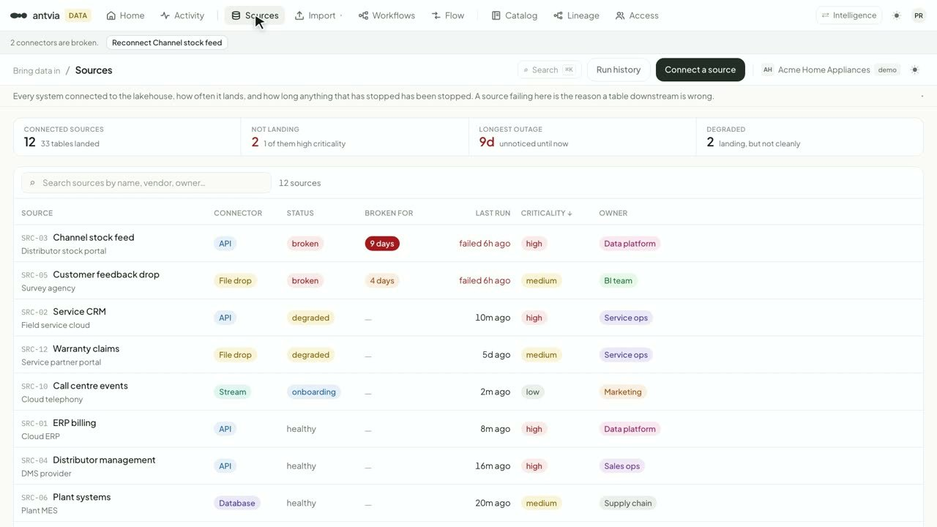
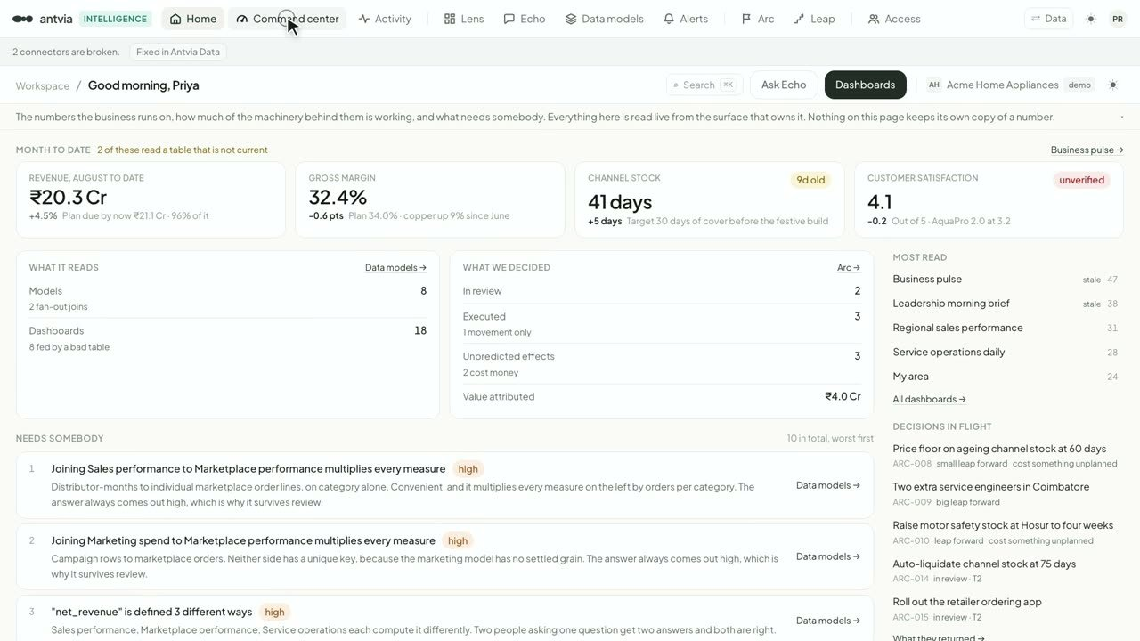

What we bring on day 1.
OUR SPECIALISATION
05 / 13
Each offer runs on its own layer, and each layer feeds the next. Our products where we built them, Anthropic where it leads.
01
02
03
Govern Data Foundations
Know Analytics
Act AI
POWERED BY
POWERED BY
BUILT ON
Antvia Data
Antvia Intelligence
Anthropic
Bronze, silver and gold lakehouse
Compliance and governance built in
Your own cloud, 300+ sources
Your data, no lock-in
Next-generation BI, with Echo
Decision tracking, proposal to execution
Access control and PII masking
Claude agents and generative AI
Implementation and automation
Certified services partner
Notes:
We do not arrive empty-handed. Antvia Data and Antvia Intelligence are ready on day 1, and AI is built directly on Claude.

Slide 6
The Leap Method™
HOW WE WORK
06 / 13
Govern · Know · Act
3×
ROI, guaranteed.
Within 12 months of delivery, or every development fee comes back to you.
01
Money metric and baseline agreed before build
Your last 12 months of real numbers. The baseline does not move.
02
Return verified by your finance team
Measured monthly, on the same data as the baseline.
03
Miss the 3×, and the dev fees are returned
The risk sits with us, not with you.
Notes:
The return is what came back divided by what was put in, measured on the client's own numbers. If we miss 3x within 12 months of delivery, the development fees are returned.

Slide 7









How an engagement runs.
ENGAGEMENT
07 / 13
Everything after the audit is scoped and priced up front. Never billed by the hour.
WEEK 1
WEEKS 2–6
WEEK 7 ONWARD
Fixed-fee audit
Build
Operate
Two calls and a written one-pager. Yours to keep whether or not you continue.
A pod of three senior people. Something real in front of real users by week three.
Quarterly reviews and on-call governance. The people who built it pick up the phone.
— The problem and the data behind it
— Our platforms ready on day 1
— Return tracked every month
— Baseline and target, in writing
— Weekly demos on your real data
— Quarterly reviews
— Fixed scope and fixed price
— Nothing writes back until you approve
— On-call governance
COVERAGE
Financial services
Retail and commerce
B2B SaaS
Public sector
Manufacturing
Logistics
Marketing firms
Healthcare and life sciences
And yours.
Notes:
Median six weeks to the first production-grade result.

Slide 8
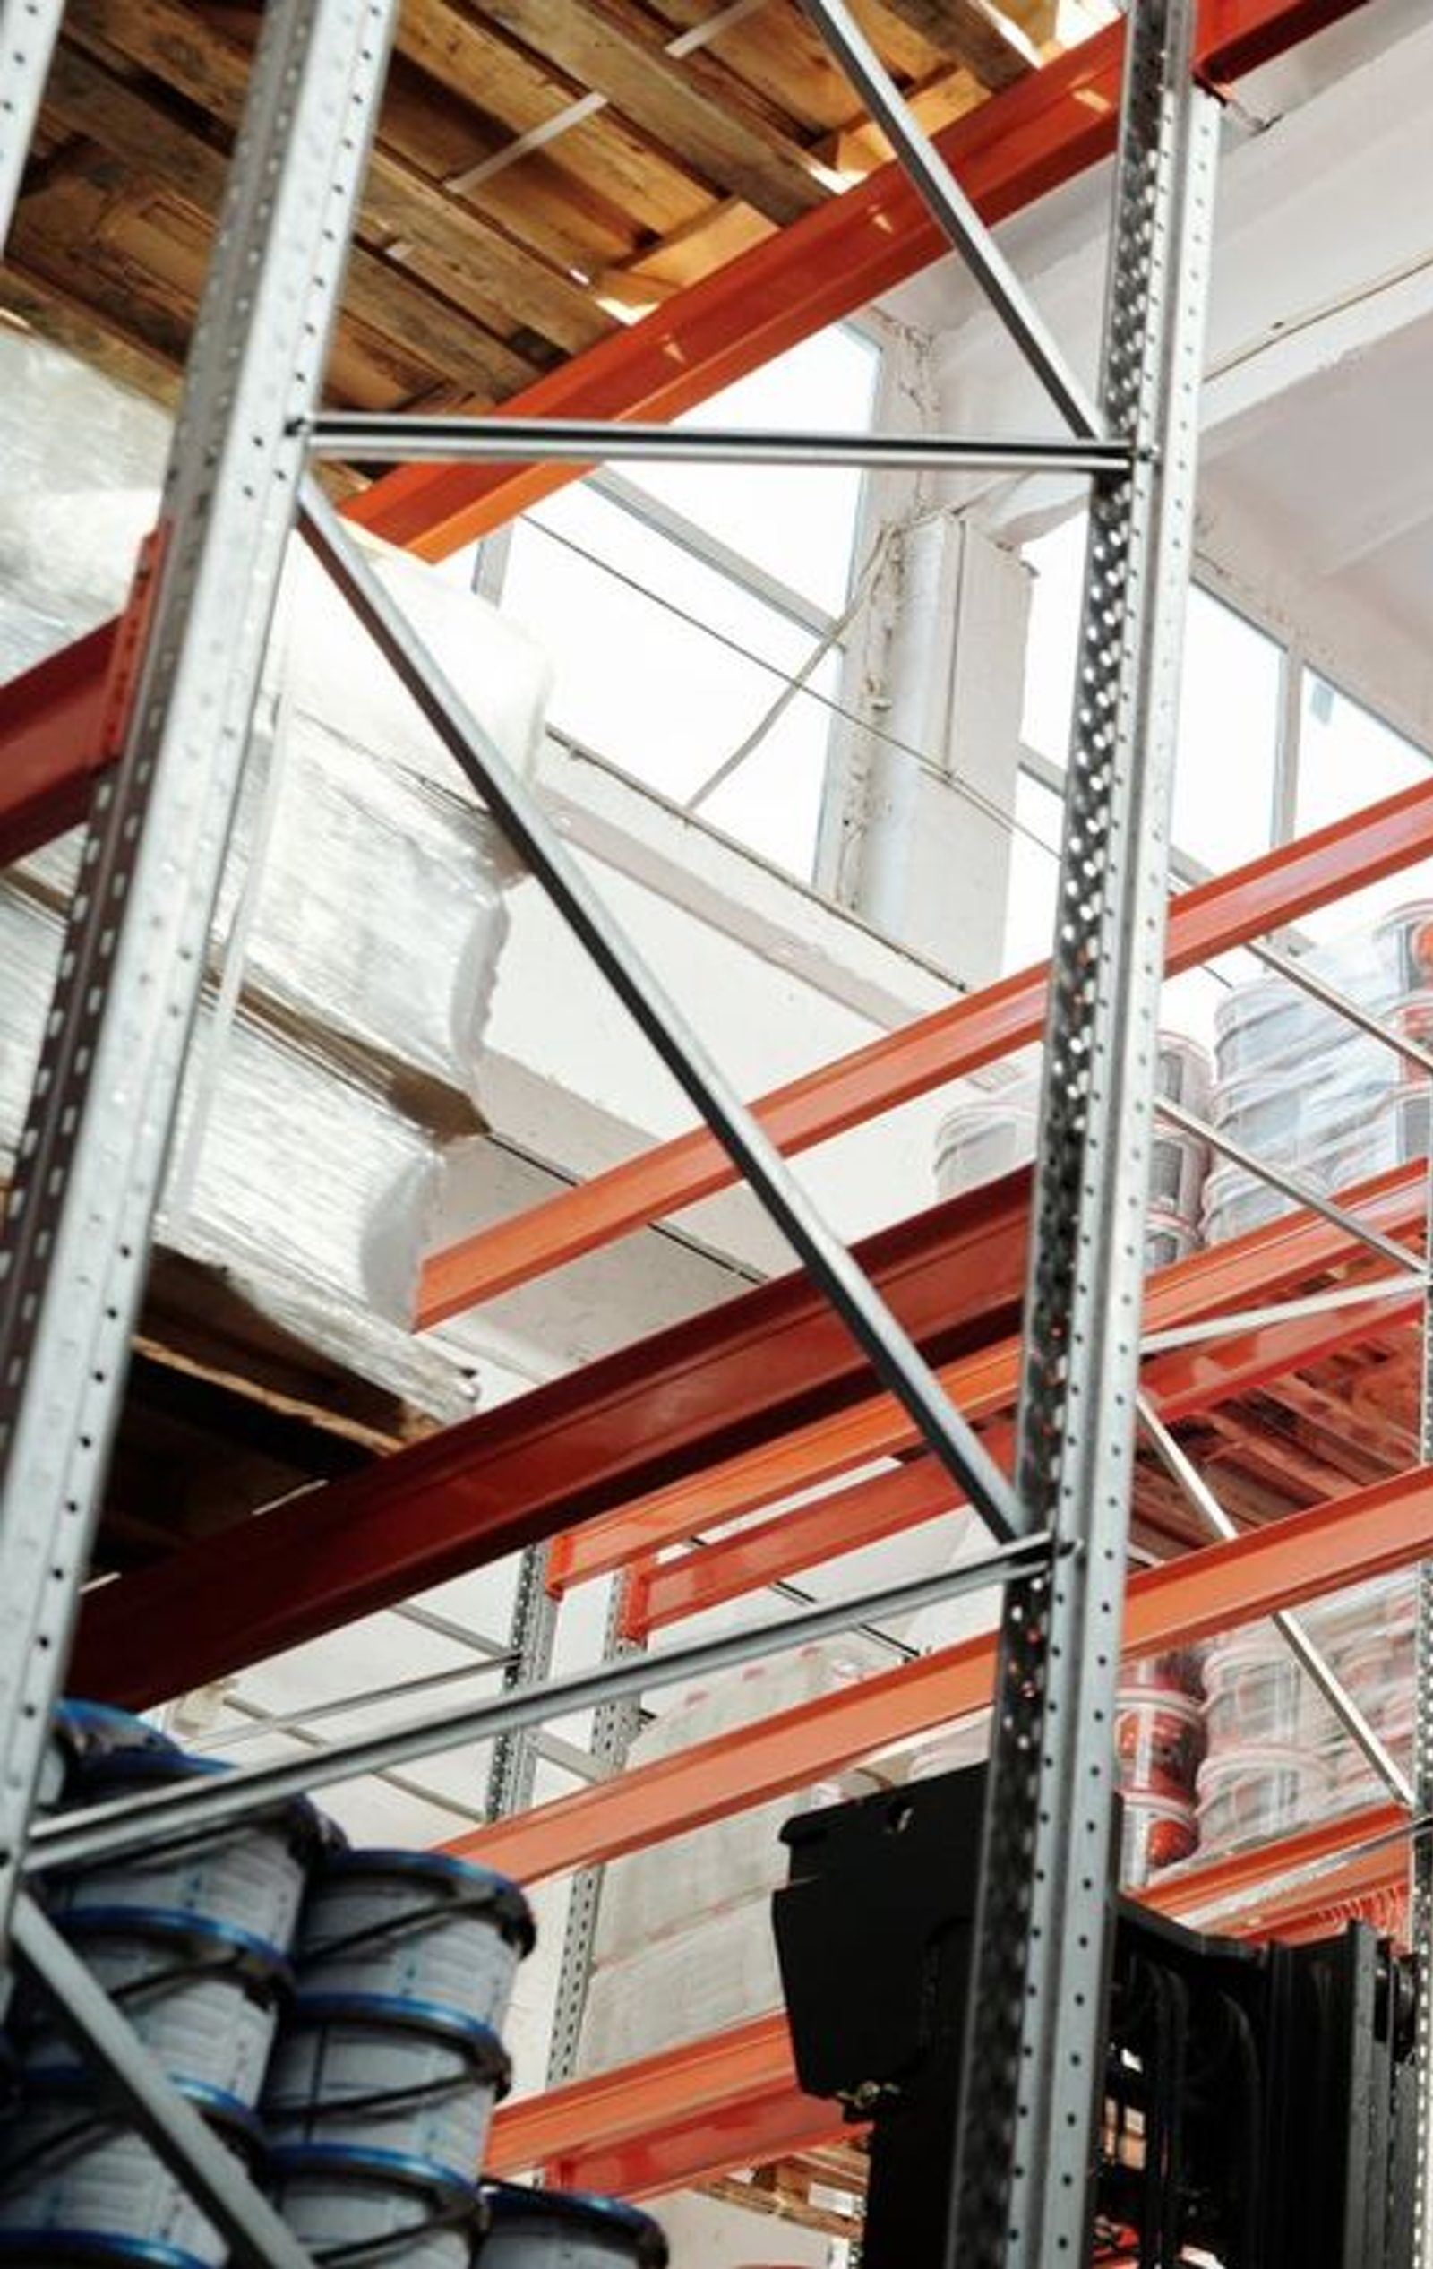


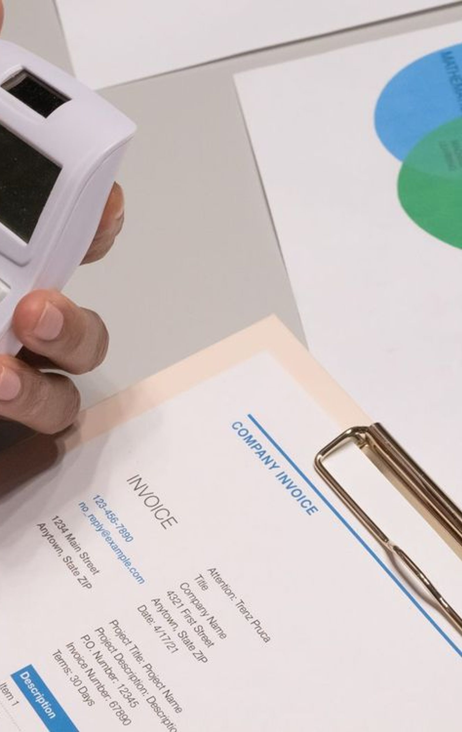
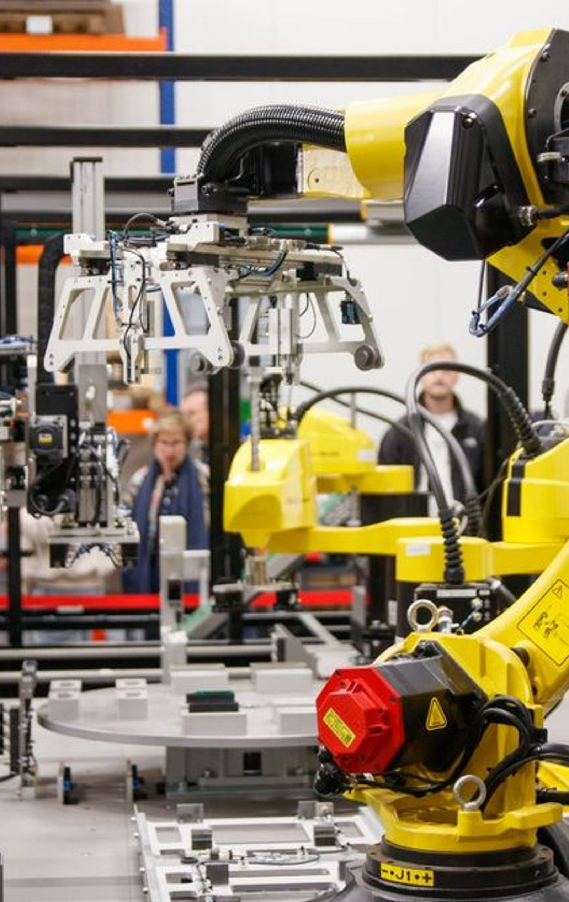

Data: one trusted copy of your data.
KEY USE CASES · DATA
08 / 13
Raw data in. Ready-to-use data out. Pipelines, storage and governance that give teams the right data at the right speed.
CLIENT RESULT
USE CASE
USE CASE
Stop retyping every challan, e-way bill and invoice
Know where every KPI on the dashboard comes from
Get 12 systems into one place without a data team
One set of records, from indent to invoice
KPI traceability, from the number to the records
Every source landed and governed in weeks
8 modules
on one set of records, in Uloborus
USE CASE
USE CASE
USE CASE
Stop month-end close eating two weeks of spreadsheets
Bring every machine on the floor into one data store
Make calls, images and video searchable
Finance pipelines, reconciled every day
Sensor and PLC data, ready for analysis
Unstructured data, ready to use
6 of 10 data use cases shown. Each has its own page on woodfrog.tech/work.
Client result, published
Use case, what we build
Notes:
Data use cases. Cards marked Client result are published case studies; the rest describe what we build, each with its own page on woodfrog.tech/work.

Slide 9


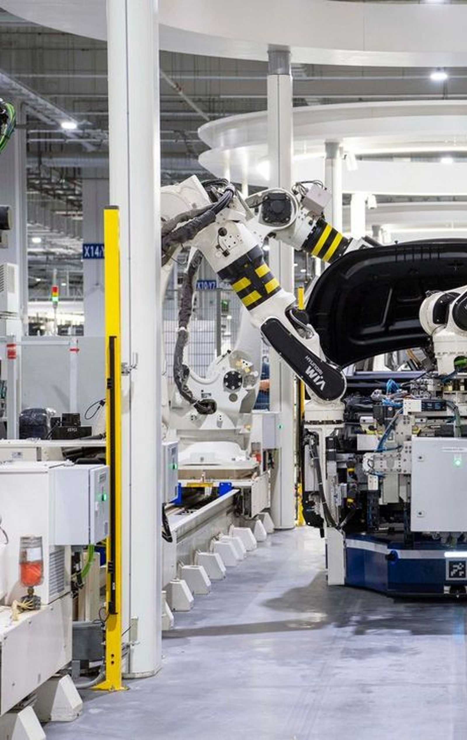
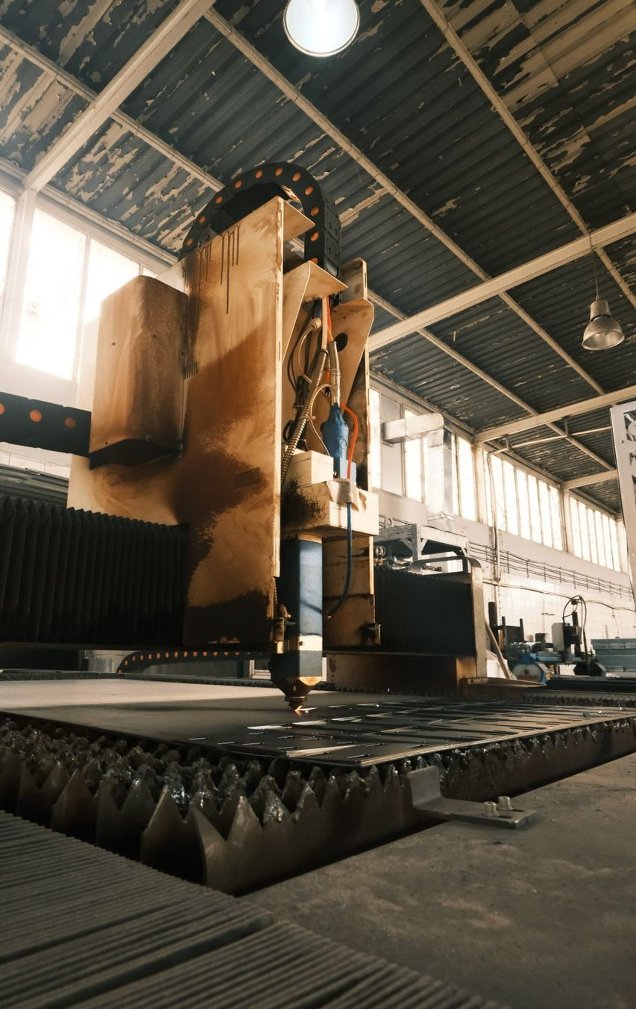

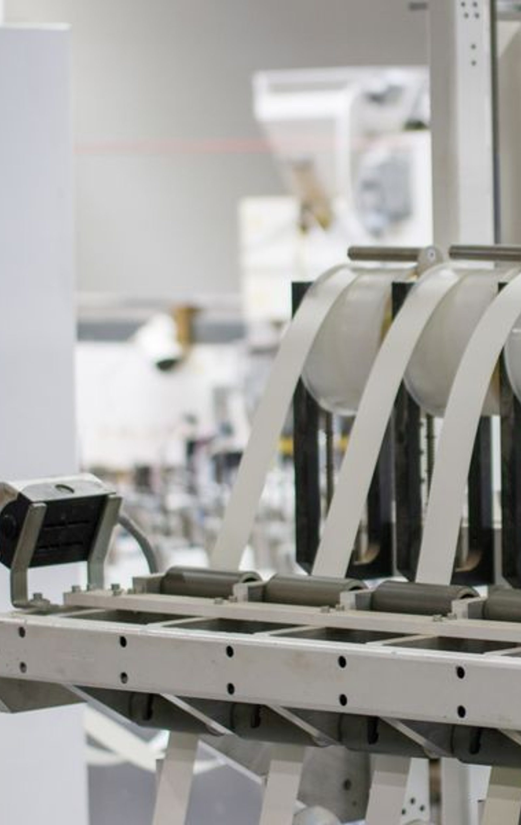
Analytics: numbers that end in a decision.
KEY USE CASES · ANALYTICS
09 / 13
Dashboards, charts and reports built around the decisions your business makes, not the data it happens to have.
CLIENT RESULT
CLIENT RESULT
CLIENT RESULT
Know which customers will leave before the renewal
Get one answer from 240 dashboards nobody trusted
Stop bad welds leaving the plant unchecked
Three signal sources read together
Eight decision dashboards, built new
An alert that names the exact car to check
$480k
240 → 8
Every weld
of yearly revenue kept, B2B SaaS
dashboards, load time 15s to 3s
measured, not a sample
CLIENT RESULT
USE CASE
USE CASE
Stop tools breaking mid-run and scrapping parts
See every morning which stores lose money, and why
Find where OEE is lost, by line and by shift
Change the tool before it breaks
Store performance command centre
Live OEE and downtime analytics
24 → 5
breakages a year, $95k saved on tools
6 of 8 analytics use cases shown. Each has its own page on woodfrog.tech/work.
Client result, published
Use case, what we build
Notes:
Analytics use cases. Cards marked Client result are published case studies; the rest describe what we build, each with its own page on woodfrog.tech/work.

Slide 10






AI: the repeat work, done by agents.
KEY USE CASES · AI
10 / 13
Agents built on Claude that read, check, call and act inside your systems, with a person approving every step that matters.
CLIENT RESULT
CLIENT RESULT
CLIENT RESULT
Find margin leaks before the books close
Stop analysts spending days writing up every backtest
Let traders build a strategy without 1,000 dropdowns
A margin agent watching landed cost
Every run writes its own summary
Describe entry and exit in plain words
$240k
60–70%
Plain words
saved a year, first alert on day 14
less research and documentation time
replace rule-by-rule set-up
USE CASE
USE CASE
USE CASE
Clear the citizen grievance backlog before it becomes a headline
Clear the claims document backlog in hours, not days
Answer every inbound call, in Hindi, Marathi or English
A triage agent reading every grievance
A document agent reading every claim
A voice agent for call handling
6 of 8 ai use cases shown. Each has its own page on woodfrog.tech/work.
Client result, published
Use case, what we build
Notes:
AI use cases. Cards marked Client result are published case studies; the rest describe what we build, each with its own page on woodfrog.tech/work.

Slide 11
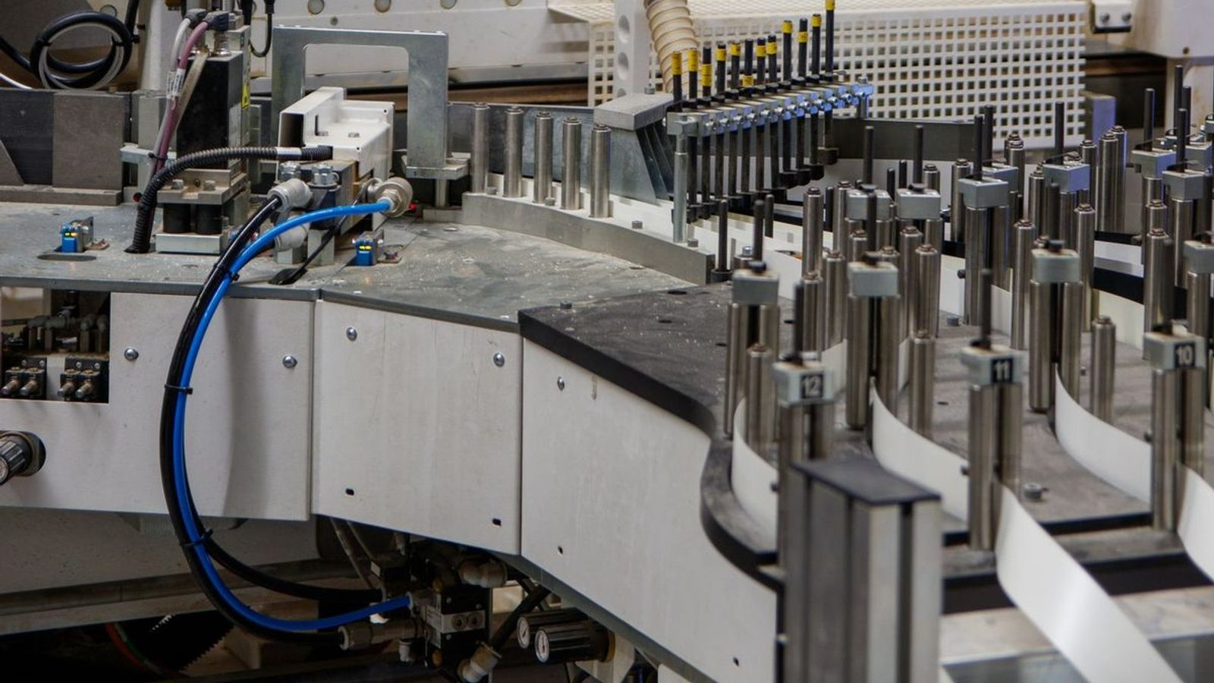

Three products we build and run.
WHAT WE HAVE BUILT
11 / 13
Built because the same problem kept arriving, and rebuilding the answer on every engagement stopped being defensible.
Antvia
Uloborus
Glimvia
antvia.io
uloborus.com
glimvia.app
A lakehouse plus a next-generation BI tool, both built.
Manufacturing operations for Indian process manufacturers.
Mobile-first KPI alerting built on Apache Superset.
Deployed into your own cloud in open formats. Column-level access control and PII masking enforced on the query itself. 300+ sources supported.
Eight modules over one set of records, from buying and quality to dispatch and invoicing, with the GST paperwork travelling with the goods.
Threshold rules on the dashboards you already run, delivered as a push carrying the metric, the threshold and the measured value.
Notes:
Antvia is the data platform. Uloborus runs manufacturing operations. Glimvia is KPI alerting on Superset.

Slide 12









Eighteen people. No handovers.
THE TEAM
12 / 13
Nobody is learning on your clock, and there is no handover in month two to a team you have never met. The people on the Week 1 call are the people you are still talking to in production. Nine of the eighteen pictured.
01
02
03
04
05
06
07
08
09
Ananta Patil
Ashish Datar
Samruddhi More
Mandar Joshi
Parth Manhas
Pranjul Kalsi
Aniket Mishra
Narendra P
Yamini Patil
Founder · CEO
Head of Marketing and Sales
Full Stack Data Developer
Full Stack Data Developer
Senior Fullstack Product Engineer
Backend and Platform Engineer
Software Engineer
Marketing Analyst
HR Officer
Notes:
Three senior people on every engagement. The people who walk your floor are the people who build it.

Slide 13

Govern · Know · Act
Contact us.
Week one is a fixed-fee audit. Two calls, a written one-pager, yours to keep.
hello@woodfrog.tech
woodfrog.tech
Pune, India
WRITE TO US
FIND US
BASED IN
LINKEDIN
linkedin.com/company/woodfrogtech
Notes:
Close on the audit: fixed fee, two calls, a one-pager the client keeps.

